Slide 1
JOBFINDER: A PERSONALIZED Résumé-JOB MATCHING SYSTEM
Shiqiang Guo， Tracy Hammond

Slide 2





Motivation
Job finding websites are one of main channels today
There are many job finding websites today.

Slide 3


They all use keyword Searching

Slide 4
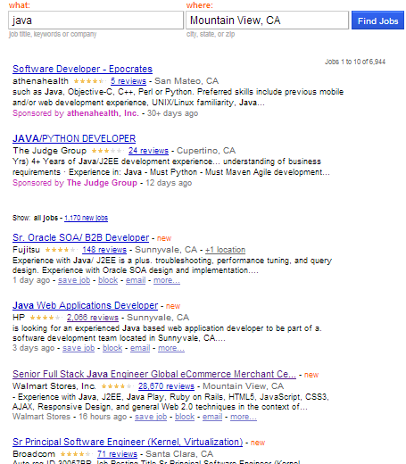
Problems of keyword Searching
When searching with Java
7000 unranked jobs returned.
Too many jobs return
The result is not ranked
Job finding become a tedious work

Slide 5
Main idea of JobFinder
A résumé has completed personal information
Education
Work experiences
Skills
Finding similarity between résumés and jobs
Ranking the jobs by their similarity value

Slide 6
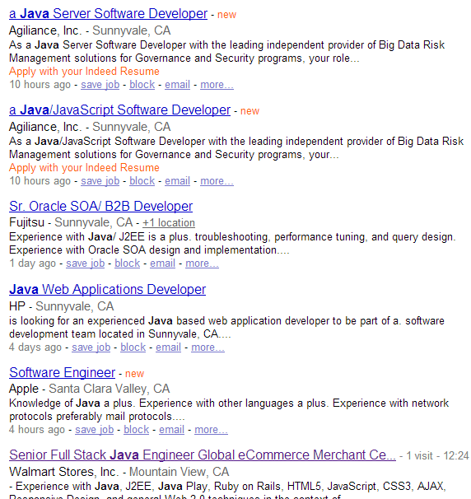
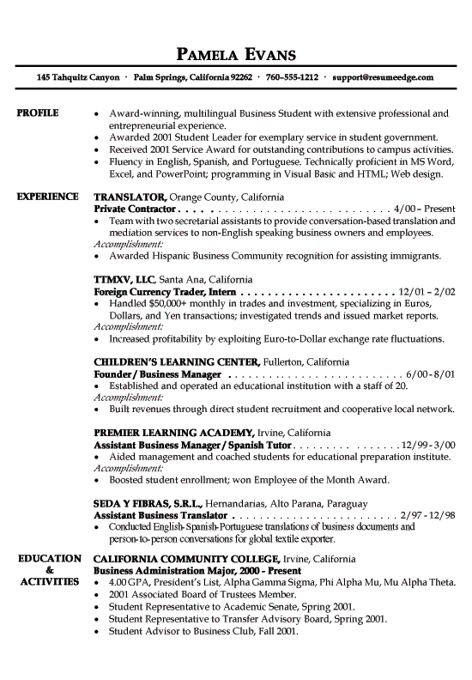
Job Finder

Slide 7
Contribution of our works
A résumé – job matching system
A finite state transducer based tool for information extraction
A semi-automatic approach to collect technical terms
A statistical-based ontology similarity measure
Combined keyword searching and model matching

Slide 8
Previous work -- Recommender Systems
Content-based Recommendation (CBR)
Suggesting items that have similar content information to the corresponding users
Collaborative Filtering Recommendation (CFR).
Finding similar users who have the same taste with the target user and recommends items based on what the similar users
Knowledge-based Recommendation (KBR)
Rules and patterns obtained from the functional knowledge of how a specific item meets the requirement of a particular use
Hybrid Recommendation

Slide 9
Previous work -- CASPER
CASPER (Rafter et. Al. 2000)
Collaborative Filtering Recommendation (CFR)
Monitor users’ behavior
Get User’s profile from server-log:
Revisit data
Read time data
Activity data

Slide 10
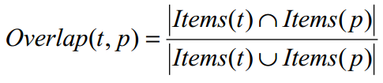

Previous work -- CASPER
Shortcomings of Collaborative Filtering
Cold start
Sparseness of users’ profiles

Slide 11
Previous work – Hybrid Recommender System
Yao Lu et. A. 2013
Content –based Recommendation
Similarity is computed using Latent Semantic Analysis (LSA)
Interaction-based Recommendation
Apply > Favorite > Like > Visit

Slide 12
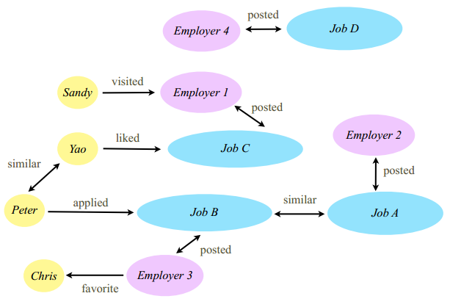
Previous work – Hybrid Recommender System

Slide 13
Previous work – Hybrid Recommender System
Recommend Job C to Peter because Yao liked Job C, and Peter and Yao have similar profiles;
Recommend Job A to Peter because Peter applied for Job B, and Job A and Job B are similar;
Recommend Employer 3 to Peter because Peter applied for Job B and Job B is posted by Employer 3;
Recommend Job B to Yao because Peter applied for Job B, and Peter and Yao have similar profiles.

Slide 14
Previous work – IBM PROSPECT
A system that aids in the shortlisting of candidates for jobs.
Using Conditional Random Fields (CRFs) model to extract the information from résumés
Filtering the candidates with facets

Slide 15
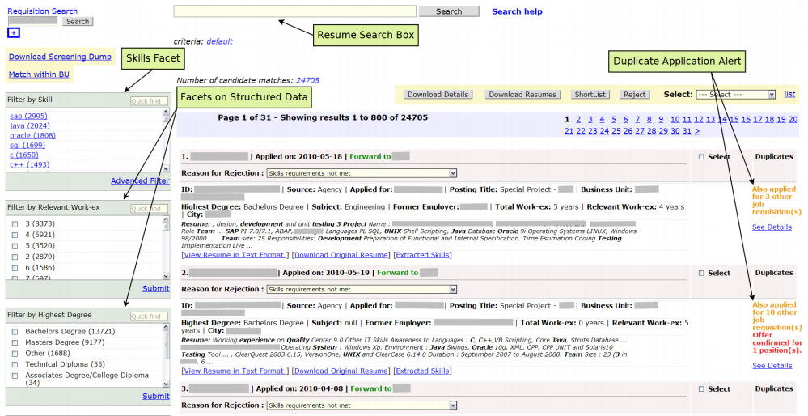
Previous work -- PROSPECT

Slide 16
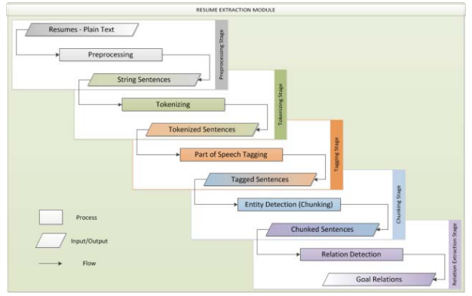
Previous work – HP Resource Planning Tool
Staged Information Extraction Framework
Resource Classification
Help recruiters to find
candidates

Slide 17
Previous work – Problems
Most systems can only process the structured data
The systems that have information extraction module are designed for recruiters
Information fields for matching résumés and job descriptions are coarse-grained.

Slide 18
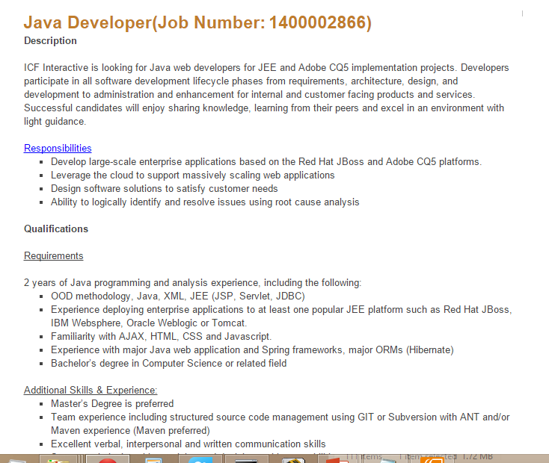
Problem Definition

Slide 19
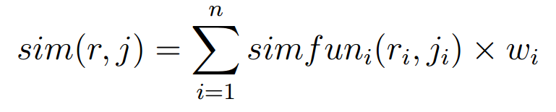
Problem Definition
r is the user‘s résumé model, r_{i} is the feature of r
j is the job description model , j_{i} is the feature of j

Slide 20
Problem Definition
J is the set of jobs in the system
Searching job → search(r, J)
Return list of jobs in J ranked by sim(r, j )

Slide 21
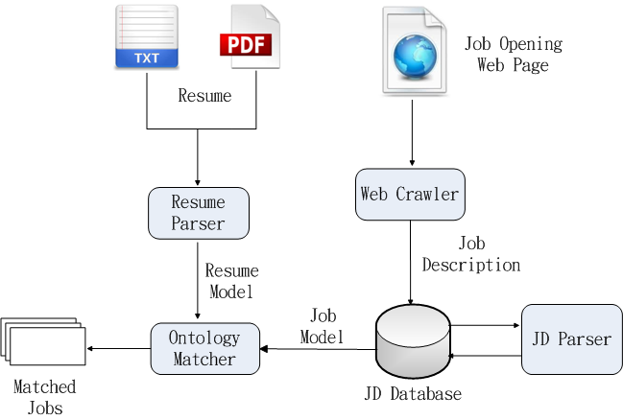
System Architecture

Slide 22
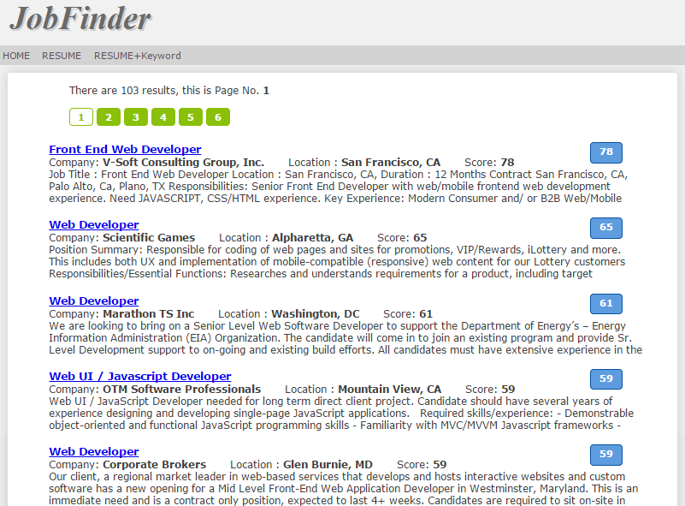
System Interface

Slide 23
Information Extraction

Slide 24
Extracting the models
Ask users to input their profiles?
Users don’t like input personal information
Recruiter don’t like input job description in web forms
So we need extract information from plaint text

Slide 25
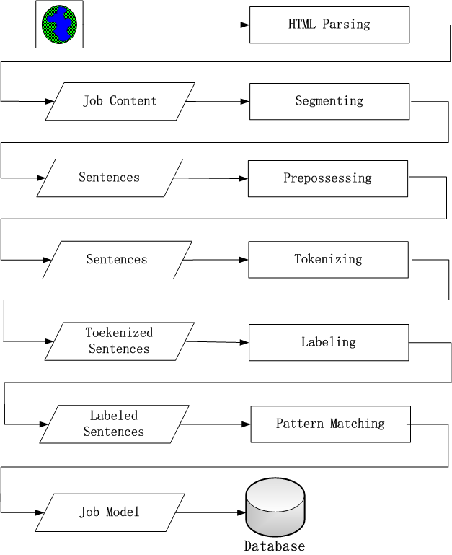
Information Extraction Stages
HTML Parsing
Segmenting
Preprocessing
Tokenizing
Labeling
Pattern Matching

Slide 26
Some sentences from Job Description
Bachelors degree in Computer or Information Systems
BS or MS in computer science or similar degree
MS/PhD Degree in Computer, Science, Engineering or Finance from top institution.
Requires a minimum of bachelors degree in a related, field or foreign equivalent.

Slide 27
Semantic Labeling
A single concept has multiple expressions
“bachelor’s degree”, the pattern will like below:
( Baccalaureate | bachelors | bachelor | B.S | BS | BA ) degree
All words mean bachelors:
Baccalaureate”, ”bachelors”, ”bachelor” ,”B.S.”, ”B.S”,”BS”,”BA”,”BA/BS”, ”BABS”, ”BSBA”, ”B.A.”, ”4-year”,”4-year”, ”4 year”, ”four year”, ”college”, ”Undergraduate” , ”University”

Slide 28
Semantic Labeling
Bachelors degree in computer science or information systems
To
DE_LEVEL | DEGREE | IN | MAJOR | OR | MAJOR | .
BS_LEVEL | DEGREE | IN | MAJOR_CS | OR | MAJOR_INFO | .
bachelors | degree | in | Computer Science | or | Information Systems | .

Slide 29
Pattern Matching
DE_LEVEL (, DE_LEVEL)* (or DE_LEVEL)? DEGREE”)
DE_LEVEL | DEGREE | IN | MAJOR | OR | MAJOR | .
BS_LEVEL | DEGREE | IN | MAJOR_CS | OR | MAJOR_INFO | .
bachelors | degree | in | Computer Science | or | Information Systems | .
DE_LEVEL | OR | MS_LEVEL | IN | MAJOR | OR | N/A | DEGREE
BS_LEVEL | OR | MS_LEVEL | IN | MAJOR_CS | OR | N/A | DEGREE
BS | or | MS | in | Computer Science | or | Similar | degree

Slide 30
Regular Expression Over Tokens
The unit of the expression is token or word
seqMatcher = parser.parse
( “ DE_LEVEL (, DE_LEVEL)* (or DE_LEVEL)? DEGREE”)

Slide 31
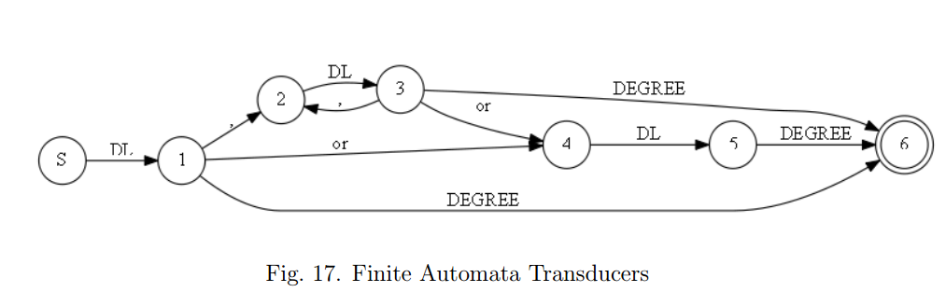
Finite Automata Transducers
A finite state transducer (FST) is a finite state machine with two tapes: an input tape and an output tape.

Slide 32
Patterns Matching Degree
DE-LEVEL, DE-LEVEL, OR DE-LEVEL
DE-LEVEL DEGREE ( IN | OF ) DT MAJOR
MAJOR-DEGREE , MAJOR-DEGREE OR MAJOR
DE-LEVEL (, DE-LEVEL)* (OR DE-LEVEL)? BE? PERFER-VBD
MAJOR DEGREE
DE_LEVEL , OR DEGREE_JJ

Slide 33
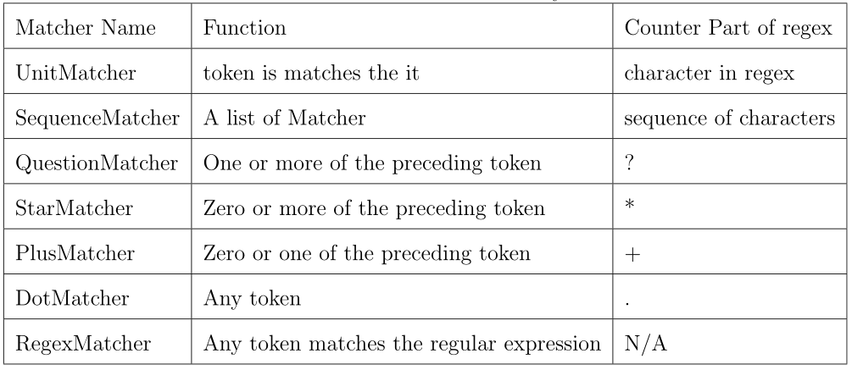
Matchers current support

Slide 34
Flexibility -- regular expression style
Pattern: DE-LEVEL DEGREE ( IN | OF ) DT? MAJOR
seqMatcher =parser.parse(”DE-LEVEL DEGREE ( IN | OF ) DT? MAJOR”)

Slide 35
Flexibility -- connected by algebra operator
Pattern: ”DE-LEVEL DEGREE (IN | OF) MAJOR”
seqMatcher = UnitMatcher(”DE-LEVEL”) + UnitMatcher(”DEGREE”) + ( UnitMatcher(”IN”) | UnitMatcher(”OF” ) ) + UnitMatcher(”MAJOR”)

Slide 36
Flexibility – OO programming style
Pattern: ”DE-LEVEL DEGREE (IN | OF) MAJOR”
matcher1 = UnitMatcher(”DE-LEVEL”)
matcher2 = UnitMatcher(”DEGREE”)
matcher3 = UnitMatcher(”IN”)
matcher4 = UnitMatcher(”OF”)
matcher5 = UnitMatcher(”MAJOR”)
matcher6 = AlternateMatcher([matcher3,matcher4])
seqMatcher = SeqMatcher([matcher1, matcher2, matcher6, matcher5])

Slide 37
Flexibility
customized in catch function and output function by lambda expression
DE_LEVEL | DEGREE | IN | MAJOR | OR | MAJOR | .
BS_LEVEL | DEGREE | IN | MAJOR_CS | OR | MAJOR_INFO | .
bachelors | degree | in | Computer Science | or | Information Systems | .

Slide 38
Flexibility – Lambda expression
lambda x:x[0] – catch the original text
lambda x:x[2] -- catch the first layer label
lambda x:x[1] – output the second layer label

Slide 39
Similarity Calculation

Slide 40
Résumé and Job Description
Part of Résumé | Part of Job Description
B.S. degree in computer science 5+ years Java 2+ year C++ Some experience in Oracle database Other experience like: Hibernate, JBOSS, JUnit, Tomcat etc. | BS degree above 4+ years Java Some experience of Python Mysql, MS-SQL Java web application Server OOA/OOD

Slide 41
How to Find terms in Job Description
A high-level language such as Java, Groovy, Ruby or Python; we use Java and Groovy extensively
HTML5/CSS3/JavaScript, web standards, jQuery or frameworks like AngularJS would be great
HTML CSS and Javascript a must 4. Experience with AJAX, XML, XSL, XSLT, CSS, JavaScript, JQuery, HTML and Web Services

Slide 42
Pattern in sentences
< term , * , *, term >
< term , * , *, and term >
Bootstrap approach
Collect fifty initial terms manually, add them to term list
Using the pattern matching library to find new terms
Checking the found terms on Dbpedia
Adding the new terms in to term list

Slide 43
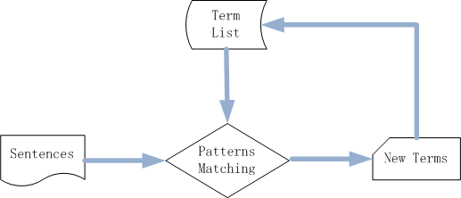
Bootstrap approach

Slide 44

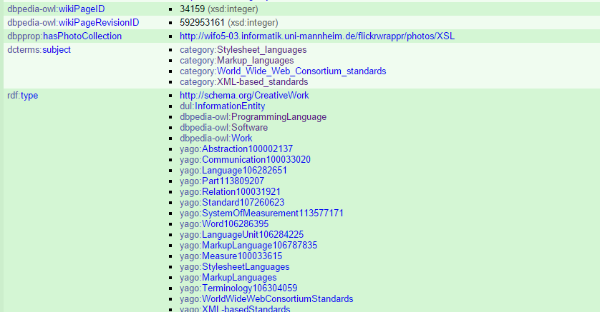
Dbpedia Page

Slide 45
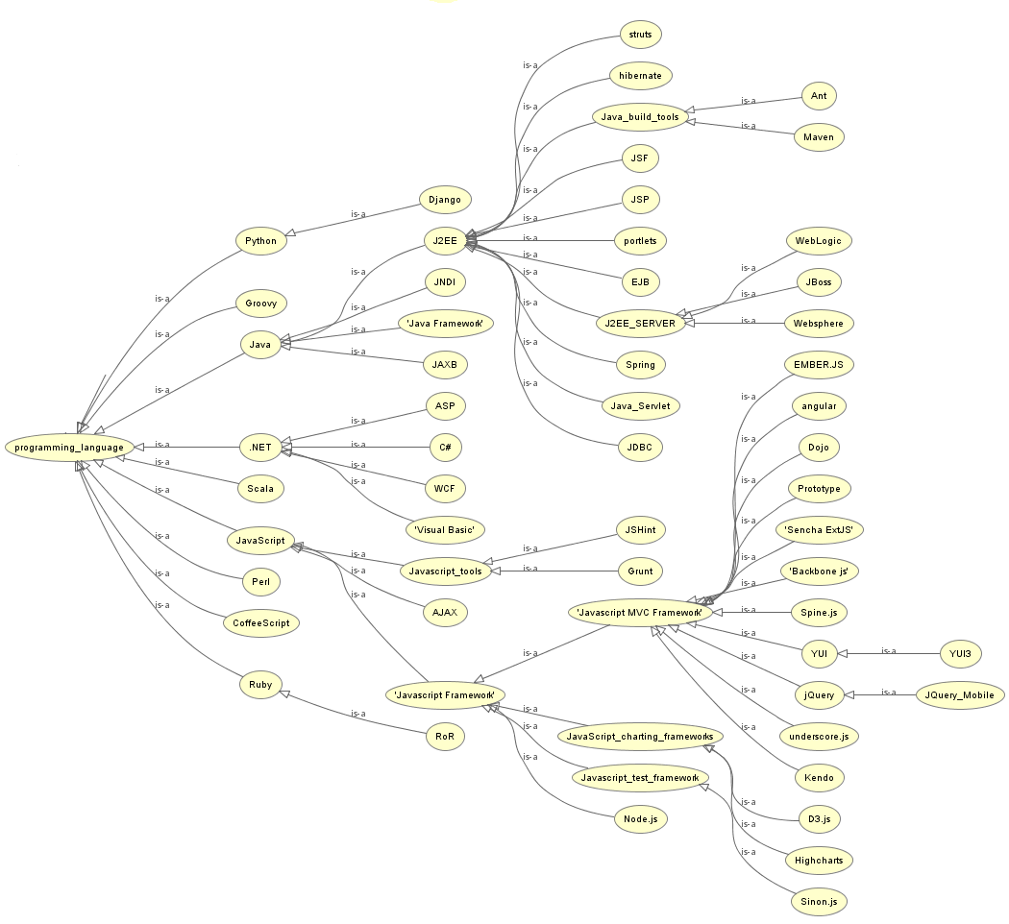

Slide 46

Ontology similarity
Path-based approaches
They assume that all links in the taxonomy have uniform distance
Feature-based measures

Slide 47
Ontology similarity
Feature-based measures
Only big ontologies/thesauri like Wordnet have this kind of information

Slide 48

Ontology similarity
Content-based measures
if the concepts do not have enough common subsumers, their similarities are hard to be calculated

Slide 49
Statistical-based Ontology Similarity Measure
A high-level language such as Java, Groovy, Ruby or Python; we use Java and Groovy extensively
HTML5/CSS3/JavaScript, web standards, jQuery or frameworks like AngularJS would be great
HTML CSS and Javascript a must 4. Experience with AJAX, XML, XSL, XSLT, CSS, JavaScript, JQuery, HTML and Web Services

Slide 50
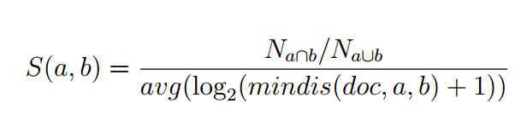
Statistical-based Ontology Similarity Measure
The numerator： The ratio of the number of documents in which the two terms exist together to the number of documents have a least one them.
The denominator： The average log value of minimum distance of the two terms in documents that have them both.

Slide 51
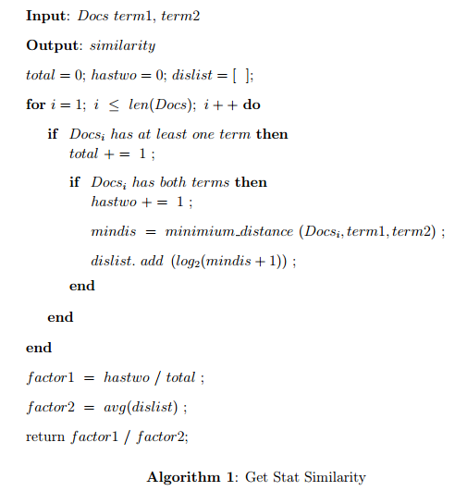
Algorithm of Similarity Calculation

Slide 52
Combine Keyword Search and Résumé Matching
Keyword searching personal preference
Ranking by model similarity values

Slide 53
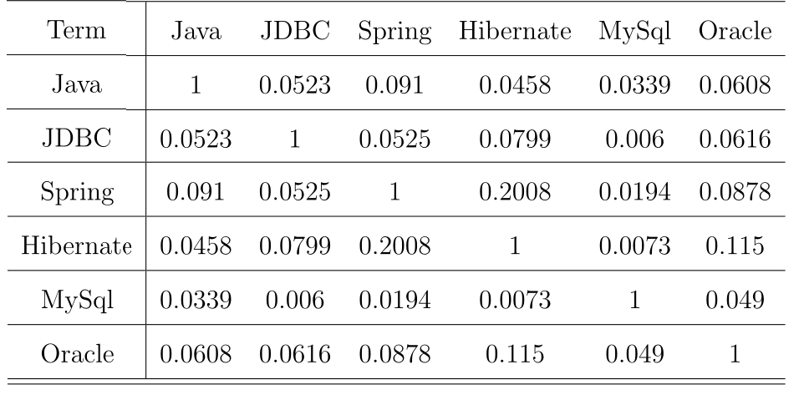
Similarity between terms

Slide 54
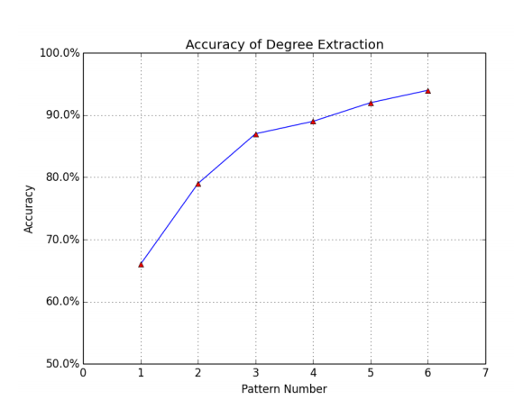
EVALUATION – Information Extraction

Slide 55
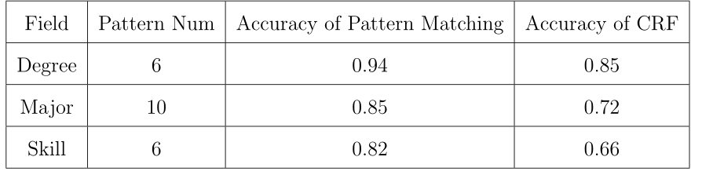
EVALUATION – Information Extraction
Accuracy of Information Extraction Comparing to CRF Model

Slide 56

EVALUATION – Ontology Similarity
Normalized Discounted Cumulative Gain(NDCG)

Slide 57
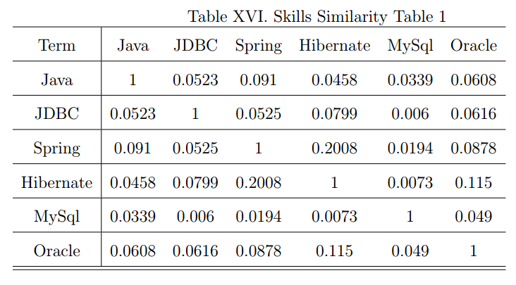
EVALUATION – Ontology Similarity

Slide 58
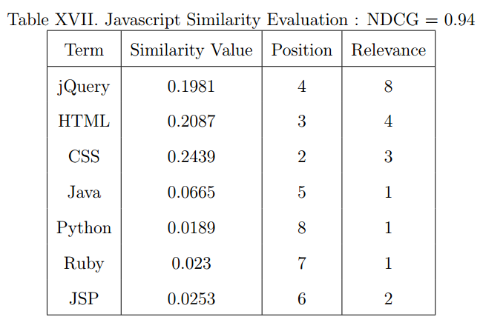
EVALUATION – Ontology Similarity

Slide 59
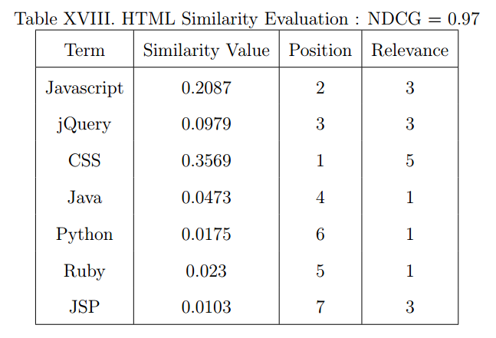
EVALUATION – Ontology Similarity

Slide 60
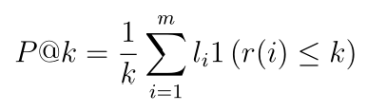
EVALUATION – System Performance
NDCG
Precision@K
The proportion of relevant documents in the first K

Slide 61
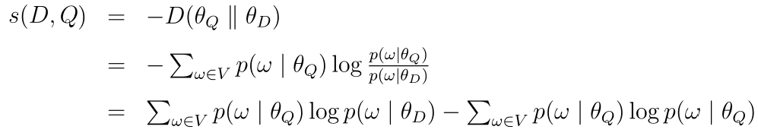
Models to Compare
Kullback-Leibler divergence

Slide 62

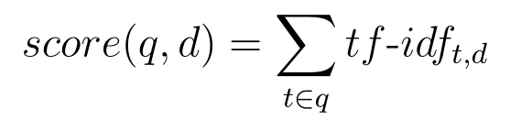
Models to Compare
TF-IDF：
TF is the term frequency
IDF is the inverse document frequency

Slide 63
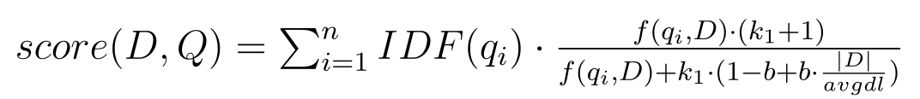
Models to Compare
Okapi BM25:
Given a query Q, containing the keywords q1,...,qn, the BM25 score of a document D

Slide 64
Experiment Setup
5 résumés
100 jobs
Relevance value manually assigned

Slide 65
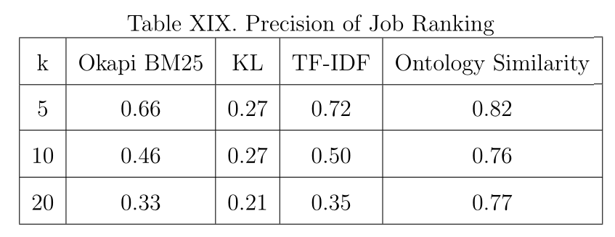
EVALUATION – System Performance

Slide 66
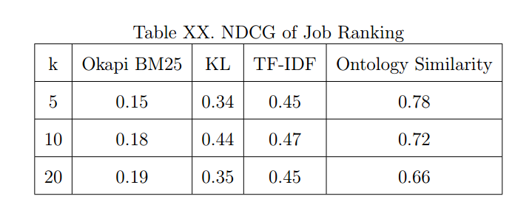
EVALUATION – System Performance

Slide 67
Summary
A résumé – job matching system
A finite state transducer based tool for information extraction
A semi-automatic approach to collect technical terms
A statistical-based ontology similarity measure
Combined keyword searching and model matching

Slide 68
Future Work
Machine learning for Information Extraction
More complex job and Résumé model
Using hybrid recommendation techniques

Slide 69
Acknowledgements
Dr. Tracy Hammond (Chair)
Dr. Anxiao Jiang (Committee member)
Dr. Daniel W. Goldberg (Committee member)
Members of Sketch Recognition Lab

Slide 70
Reference
ACM. (2012) Acm computing classication system. [Online]. Available: http://www.acm.org/about/class/2012
A. V. Aho and J. D. Ullman, Foundations of computer science. Computer Science Press New York, 1992, vol. 2.
S. T. Al-Otaibi and M. Ykhlef, \A survey of job recommender systems," International Journal of the Physical Sciences, vol. 7, no. 29, pp. 5127{5142, 2012.
D. E. Appelt and B. Onyshkevych, \The common pattern specication language," in Proceedings of a workshop on held at Baltimore, Maryland: October 13-15, 1998. Association for Computational Linguistics, 1998, pp. 23{30.
S. Bird, \Nltk: the natural language toolkit," in Proceedings of the COLING/ACL on Interactive presentation sessions. Association for Computational Linguistics, 2006, pp. 69 - 72.
C. Bizer, J. Lehmann, G. Kobilarov, S. Auer, C. Becker, R. Cyganiak, and S. Hellmann, \Dbpedia-a crystallization point for the web of data," Web Semantics: science, services and agents on the world wide web, vol. 7, no. 3, pp.154-165, 2009.

Slide 71
Thank you

